Slide 1
MASTER’S DEGREE THESIS IN COMPUTER ENGINEERING
Master Degree in
COMPUTER ENGINEERING
Vibration-based Terrain Recognition for E-Bikes Using Inertial Sensor Measurements
SPEAKER
Cristiano Gambirasio
Matr. 1066866
PLACE
University of Bergamo

Slide 2
Outline
Introduction
Data acquisition
Preprocessing & Feature Extraction
Classification Algorithm
Conclusion

Slide 3
Outline
Introduction
Data acquisition
Preprocessing & Feature Extraction
Classification Algorithm
Conclusion

Slide 4
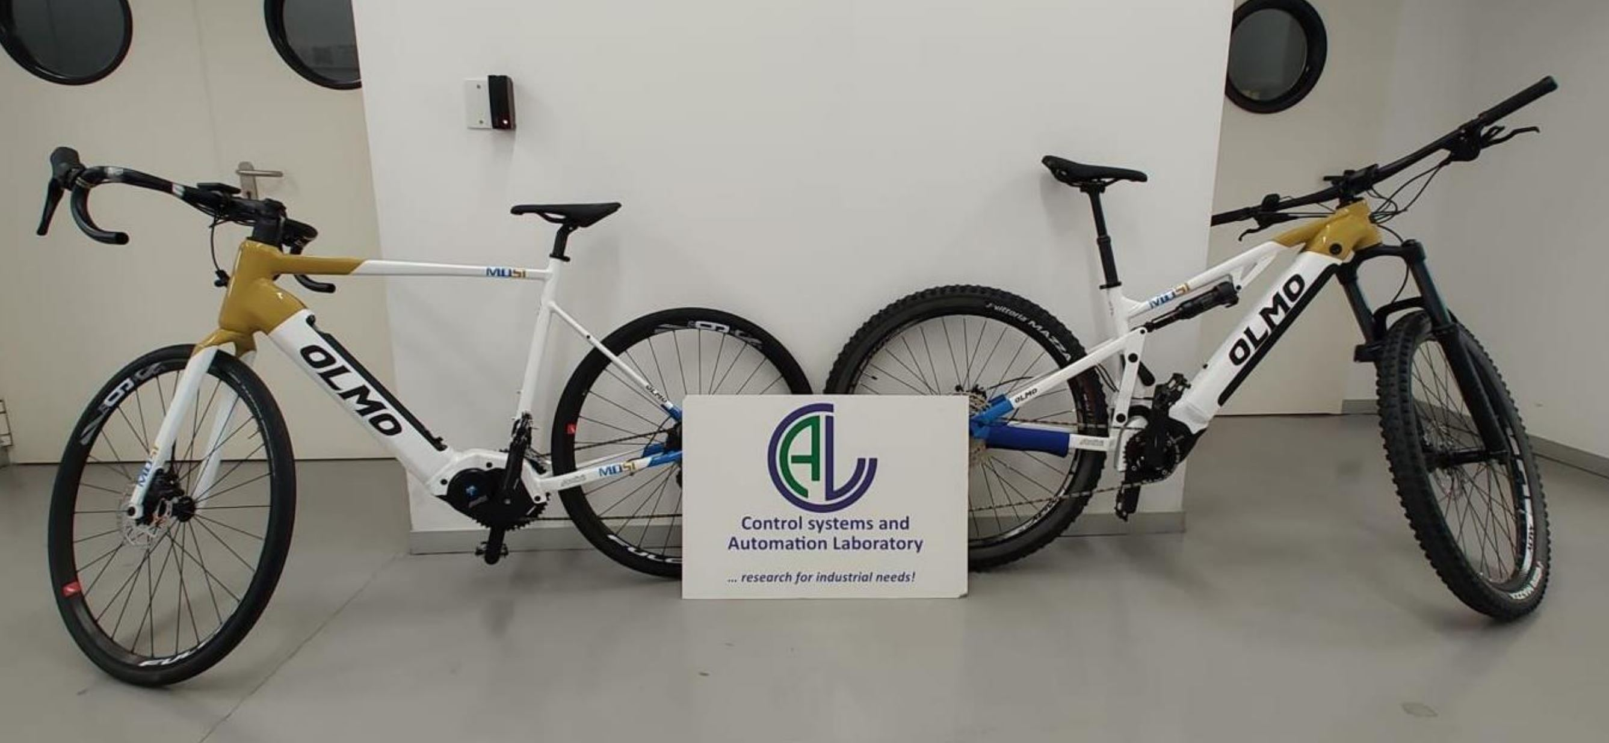
Introduction – Problem Statement
This project will implement an algorithm of Terrain Recognition for a sensorized e-bike.
Project Goals:
Predict the underneath terrain accurately
Display as output a stable prediction

Slide 5
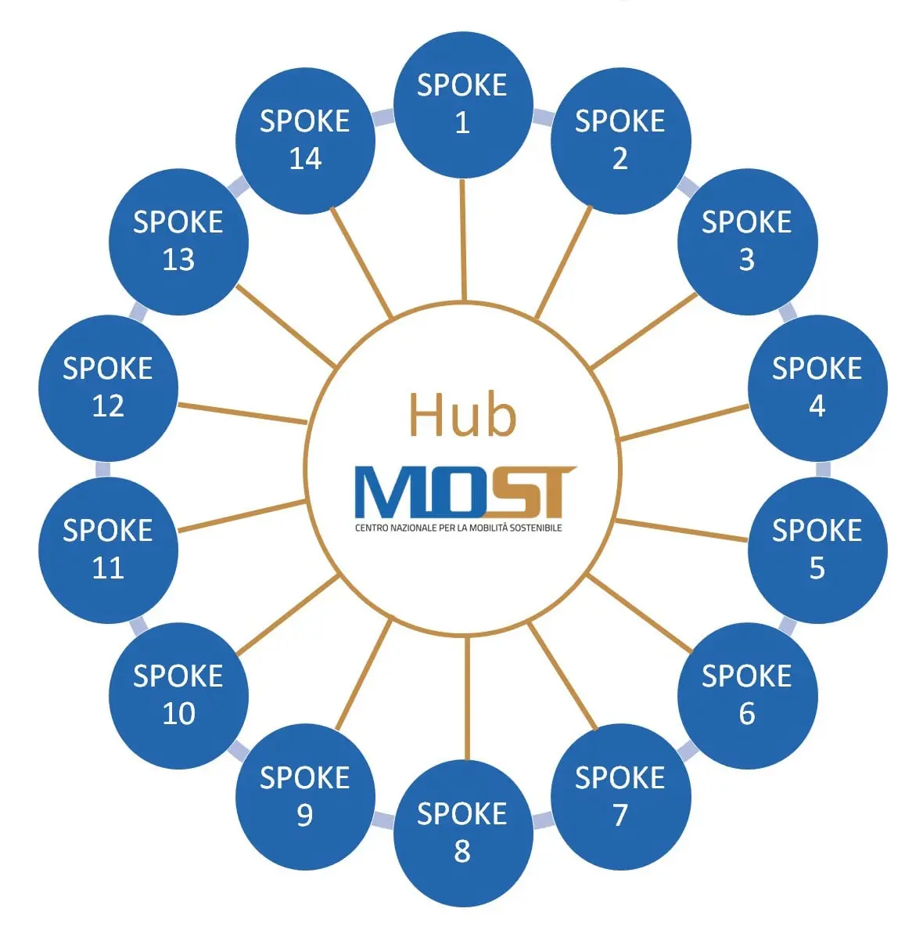

Introduction – MOST
MOST is a National Center of Research and Development provided by the PNRR
The Center is dedicated to sustainable mobility.
It follows the ‘Hub&Spoke’ model.
Active Mobility and Light Vehicle
Spoke Leader:

Slide 6
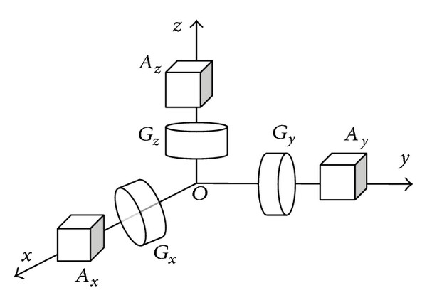
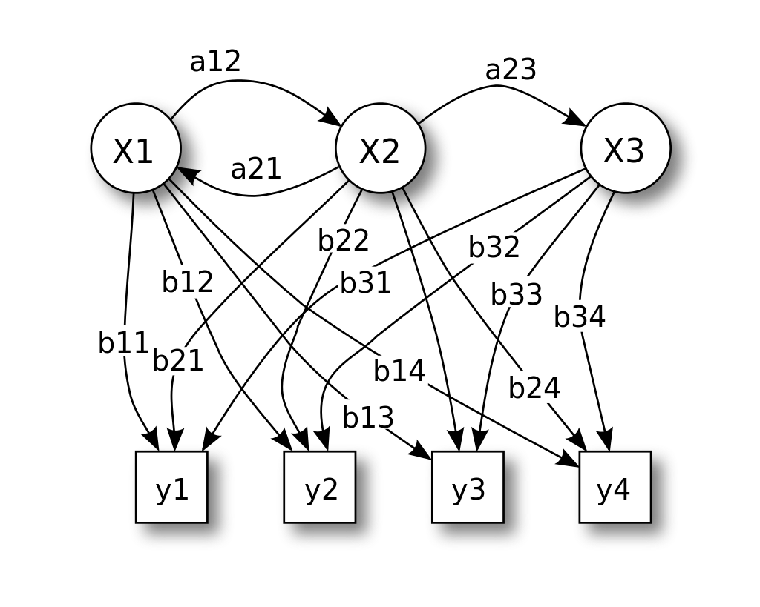
Introduction – Approach
This task can be solved with a data-driven approach.
Input
Sensing
Preprocessing &
Feature Extraction
Classification
Prediction
Inertial Measurements Unit
Support Vector Machine + Hidden Markov Model
x₂
x₁

Slide 7
Outline
Input
Sensing
Preprocessing &
Feature Extraction
Classification
Prediction
Introduction
Data acquisition
Preprocessing & Feature Extraction
Classification Algorithm
Conclusion

Slide 8
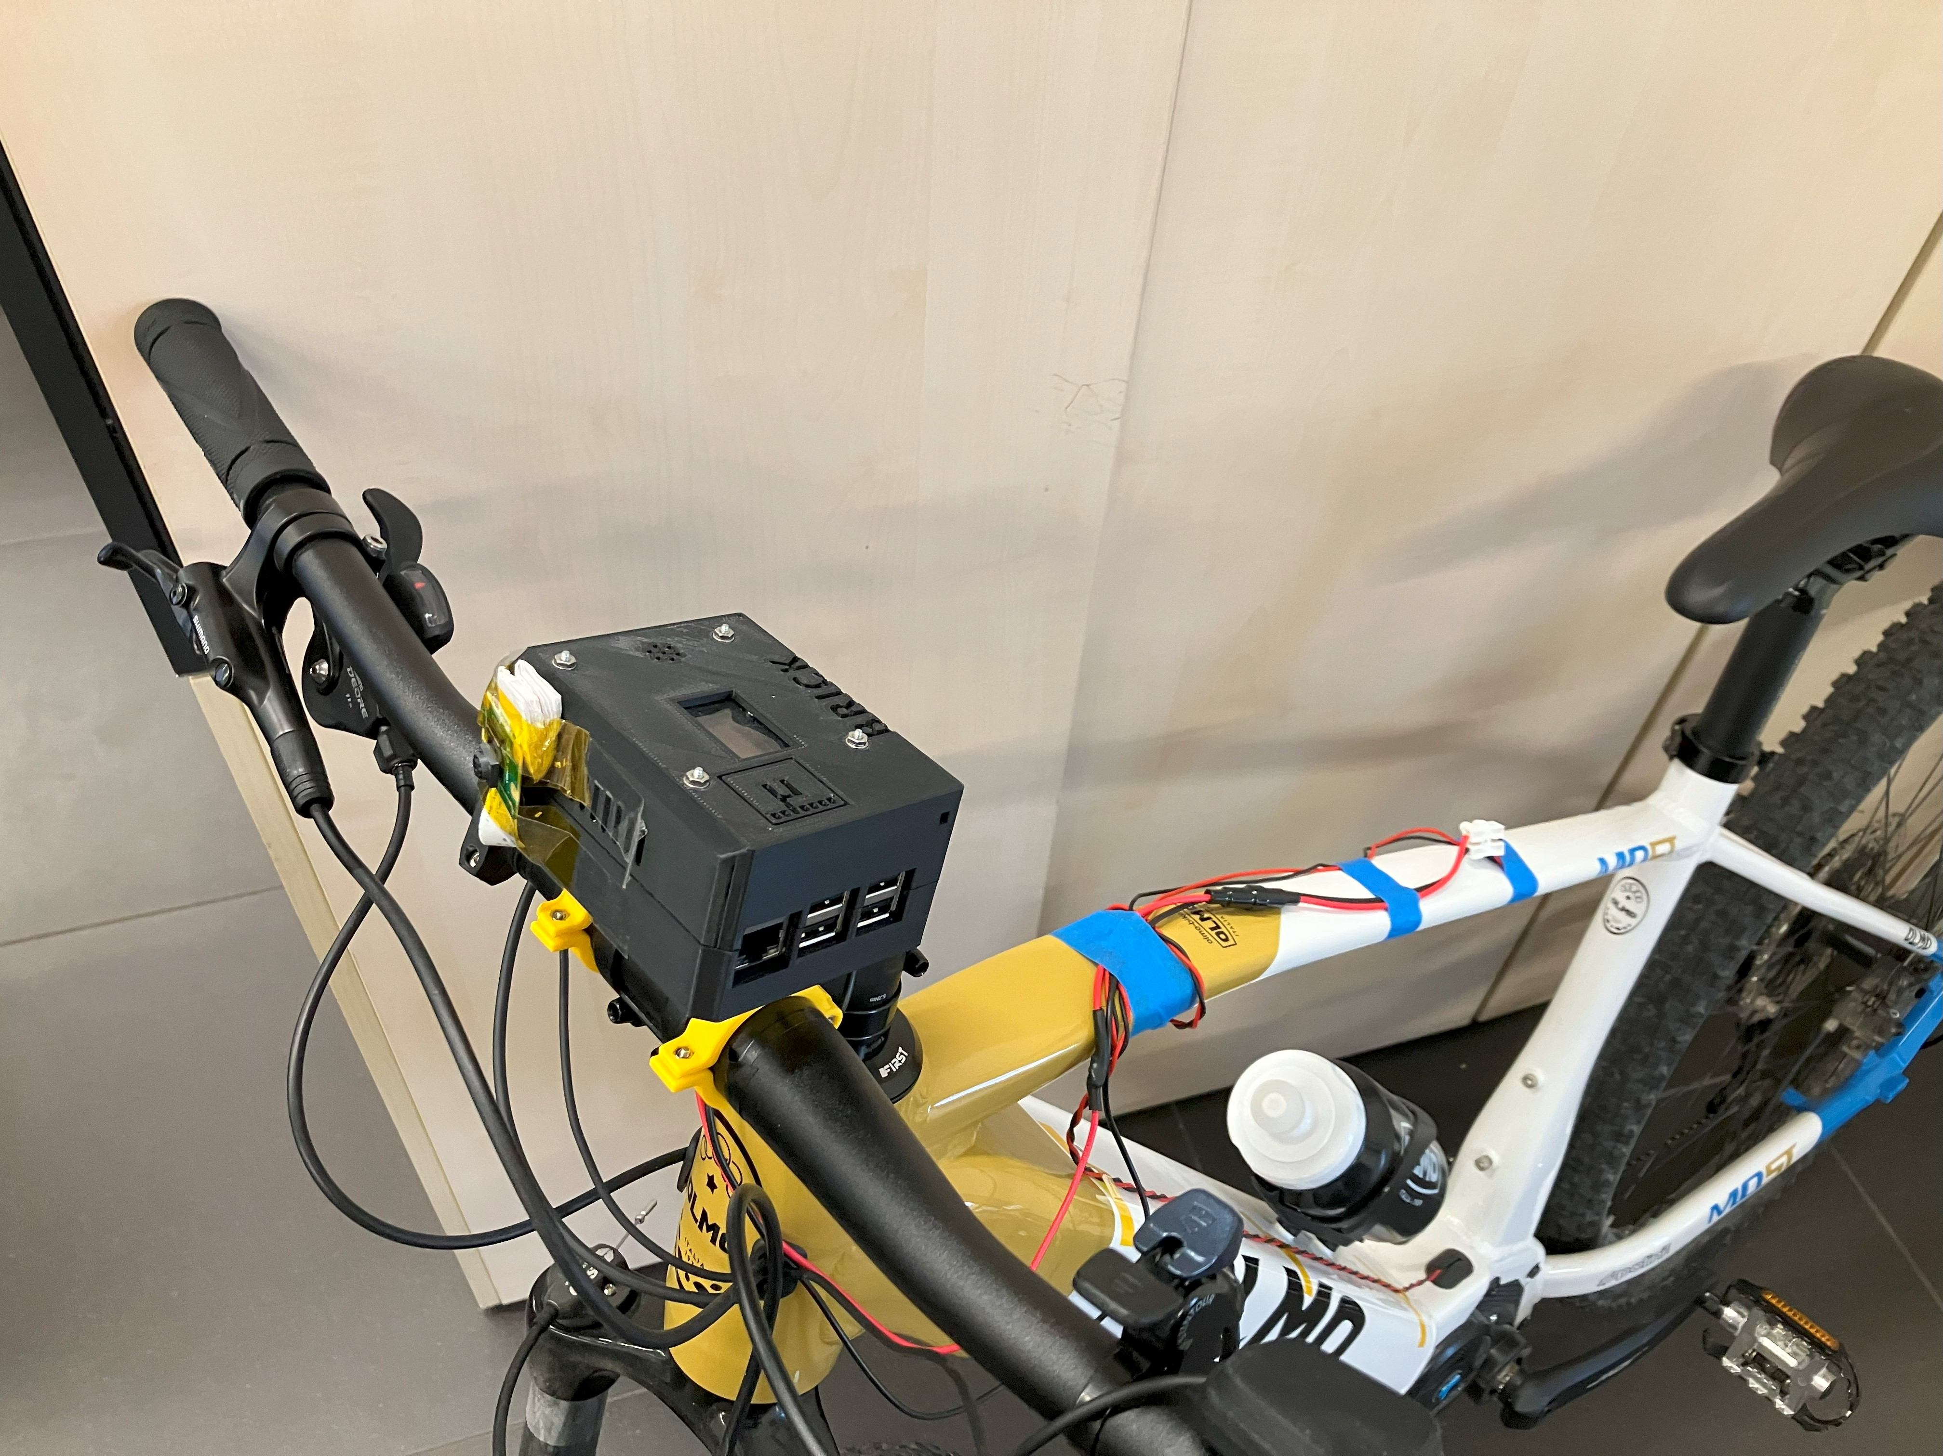
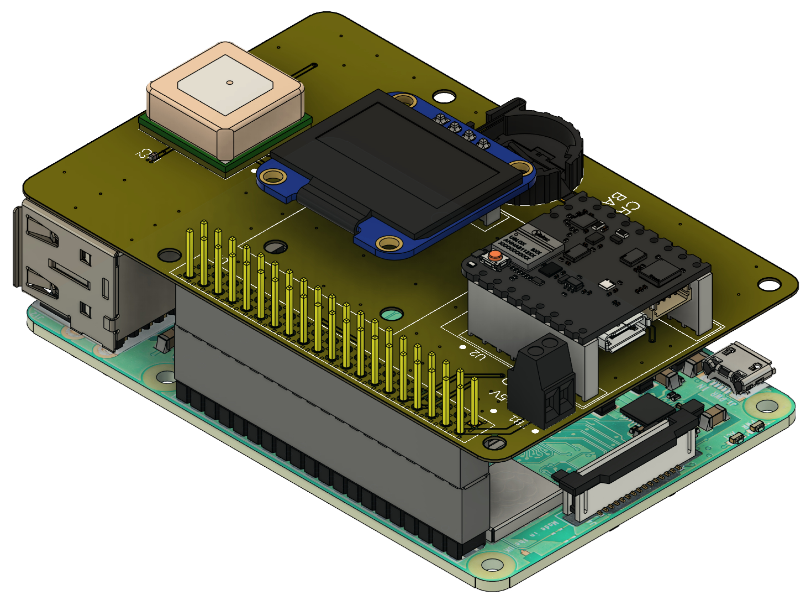
Data acquisition – Hardware configuration
BRICK
A Raspberry Pi acts as Data Aggregation Module and gather measurements from:
IMU
Environmental Sensor
GPS
Motor Sensor
Battery Sensor
Sampling rate of:
100 Hz

Slide 9
Data acquisition – Experiments definition
The training dataset must cover as much as possible of the bike ride scenarios.
The following parameters were varied during the experiments:
Terrain [Asphalt; Cobblestone; Gravel]
Speed [15km/h; 25km/h]
Assistance level [Level 0; Level 3; Level 5]
Damper setting [Locked; Unlocked]
The combination of these factors defines 36 different experiments to cover all the possible scenarios.
Only 21 of these were carried out.

Slide 10
Outline
Input
Sensing
Preprocessing &
Feature Extraction
Classification
Prediction
Introduction
Data acquisition
Preprocessing & Feature Extraction
Classification Algorithm
Conclusion

Slide 11
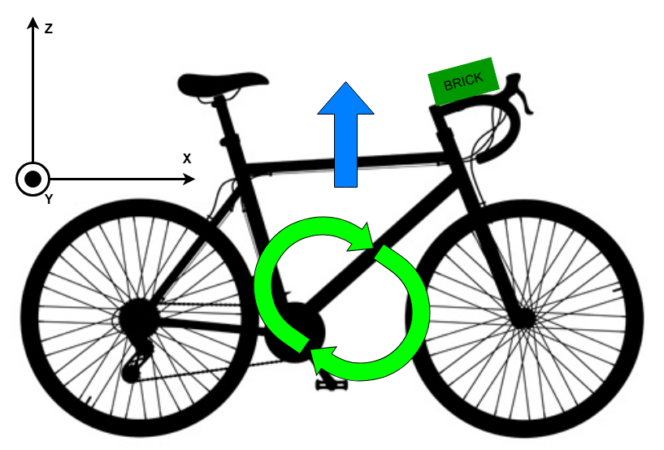

Preprocessing
Computing a new value
Dataset cleaning
The norm of the three acceleration components has been added to the dataset.
Only the relevant signals are kept in the dataset:
X and Z axes of the accelerometer
Y axis of the gyroscope
Norm of acceleration components
z
a
a_{z}
a_{x}
x
a_{y}
y

Slide 12


Preprocessing – Dataset segmentation
Inertial measurements are of little significance when considering only the instantaneous sensed value; It is more useful to classify time intervals.
x₁
x₂
. . .
x₃₉
x₄₀
Acc_{x}
Acc_{z}
Acc_{norm}
Gyro_{y}
t₁
t₂
Group 1
t₃
.
.
.
Group 2
Preprocessing
Group 3
.
.
.
$×$3
Group n-1
t_{N-2}
t_{N-1}
Group n
t_{N}

Slide 13
Feature extraction – Time-domain features
To extract scalar features from the intervals in the time domain, statistics on the groups were calculated:
Mean value
Variance
Count of 4 thresholds crossing
Minimum value
Maximum value
Measurements Group
Sample
Acc_{x}
Acc_{z}
Acc_{norm}
Gyro_{y}
Mean_{Accx}
Var_{Accx}
. . .
Max_{Gyroy}
Feature
Extraction

Slide 14
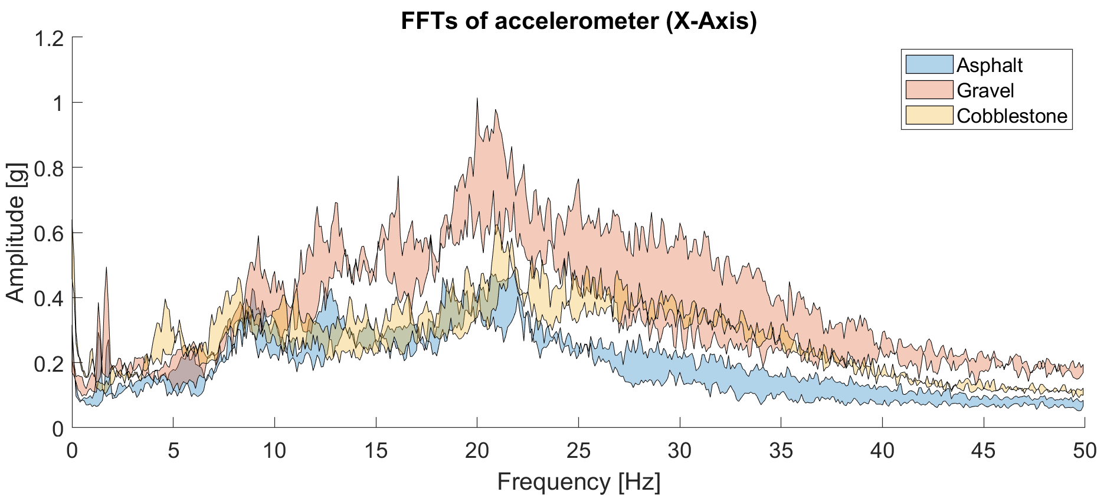
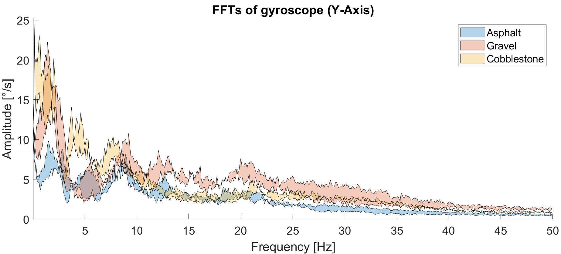
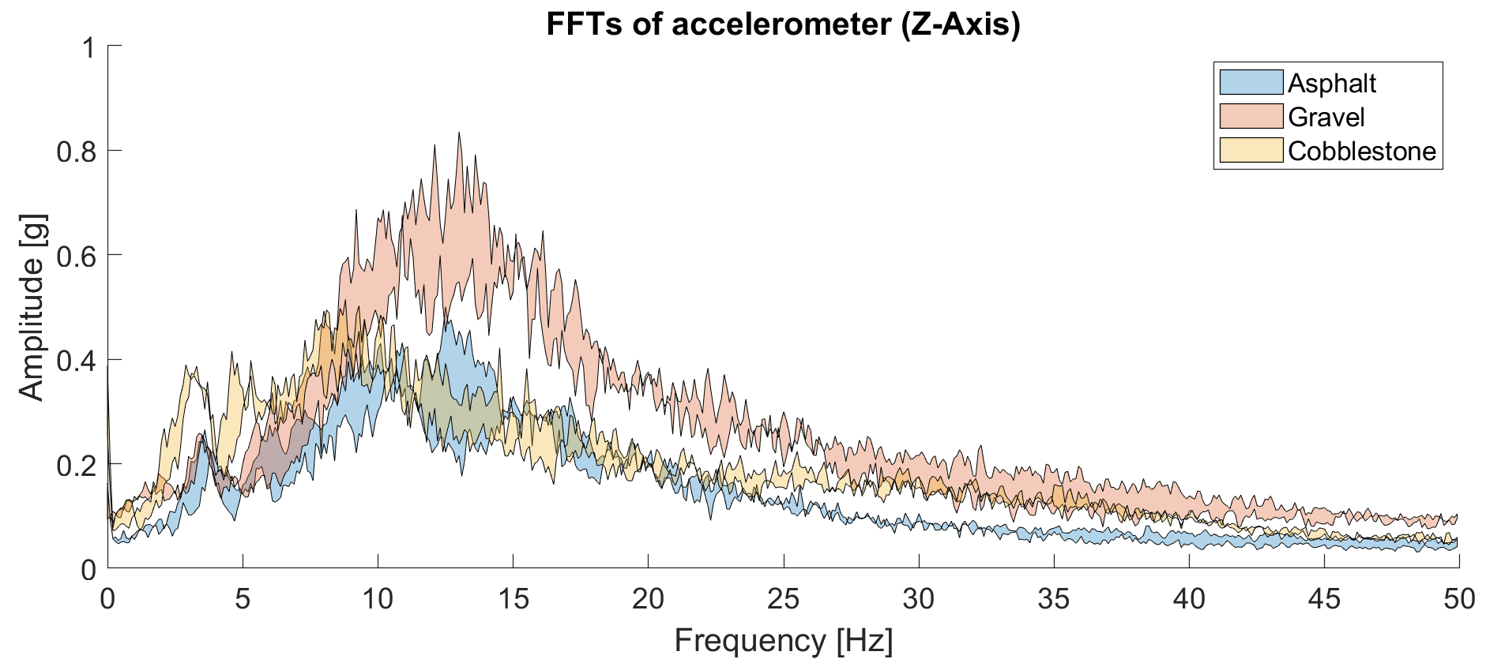
Feature extraction – Frequency domain features
18-23 Hz
Other features can be extracted by observing the frequency response of the IMU signals, looking for frequency bands that characterize the terrains.
25-50 Hz
4-7 Hz
1-3 Hz
3-7 Hz
2-5 Hz
30-50 Hz

Slide 15
Outline
Input
Sensing
Preprocessing &
Feature Extraction
Classification
Prediction
Introduction
Data acquisition
Preprocessing & Feature Extraction
Classification Algorithm
Conclusion

Slide 16


Classification Algorithm – Model training
Train
set
Train
Set
Train
set
Train
Set
Train
Set
The cross-validation technique has been used to tune the hyperparameters of the model.
Standardization
Kernel function
Box Constraint
Test
Set
Train
Set
Test
set
Test
set
Test
set
Dataset
The training dataset is fed to the fitting algorithm to train the model.
SVM Fitting Algorithm
Trained
SVM

Slide 17
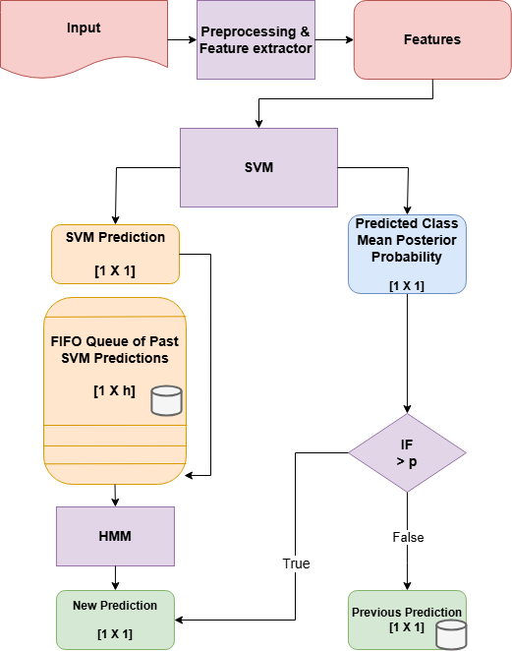
Classification Algorithm – Complete algorithm
The SVM alone does not consider the shape of the output.
Two post-processing techniques were implemented to improve the stability of the predictions.
Output modeling using a Hidden Markov Model
Rejection of uncertain predictions

Slide 18

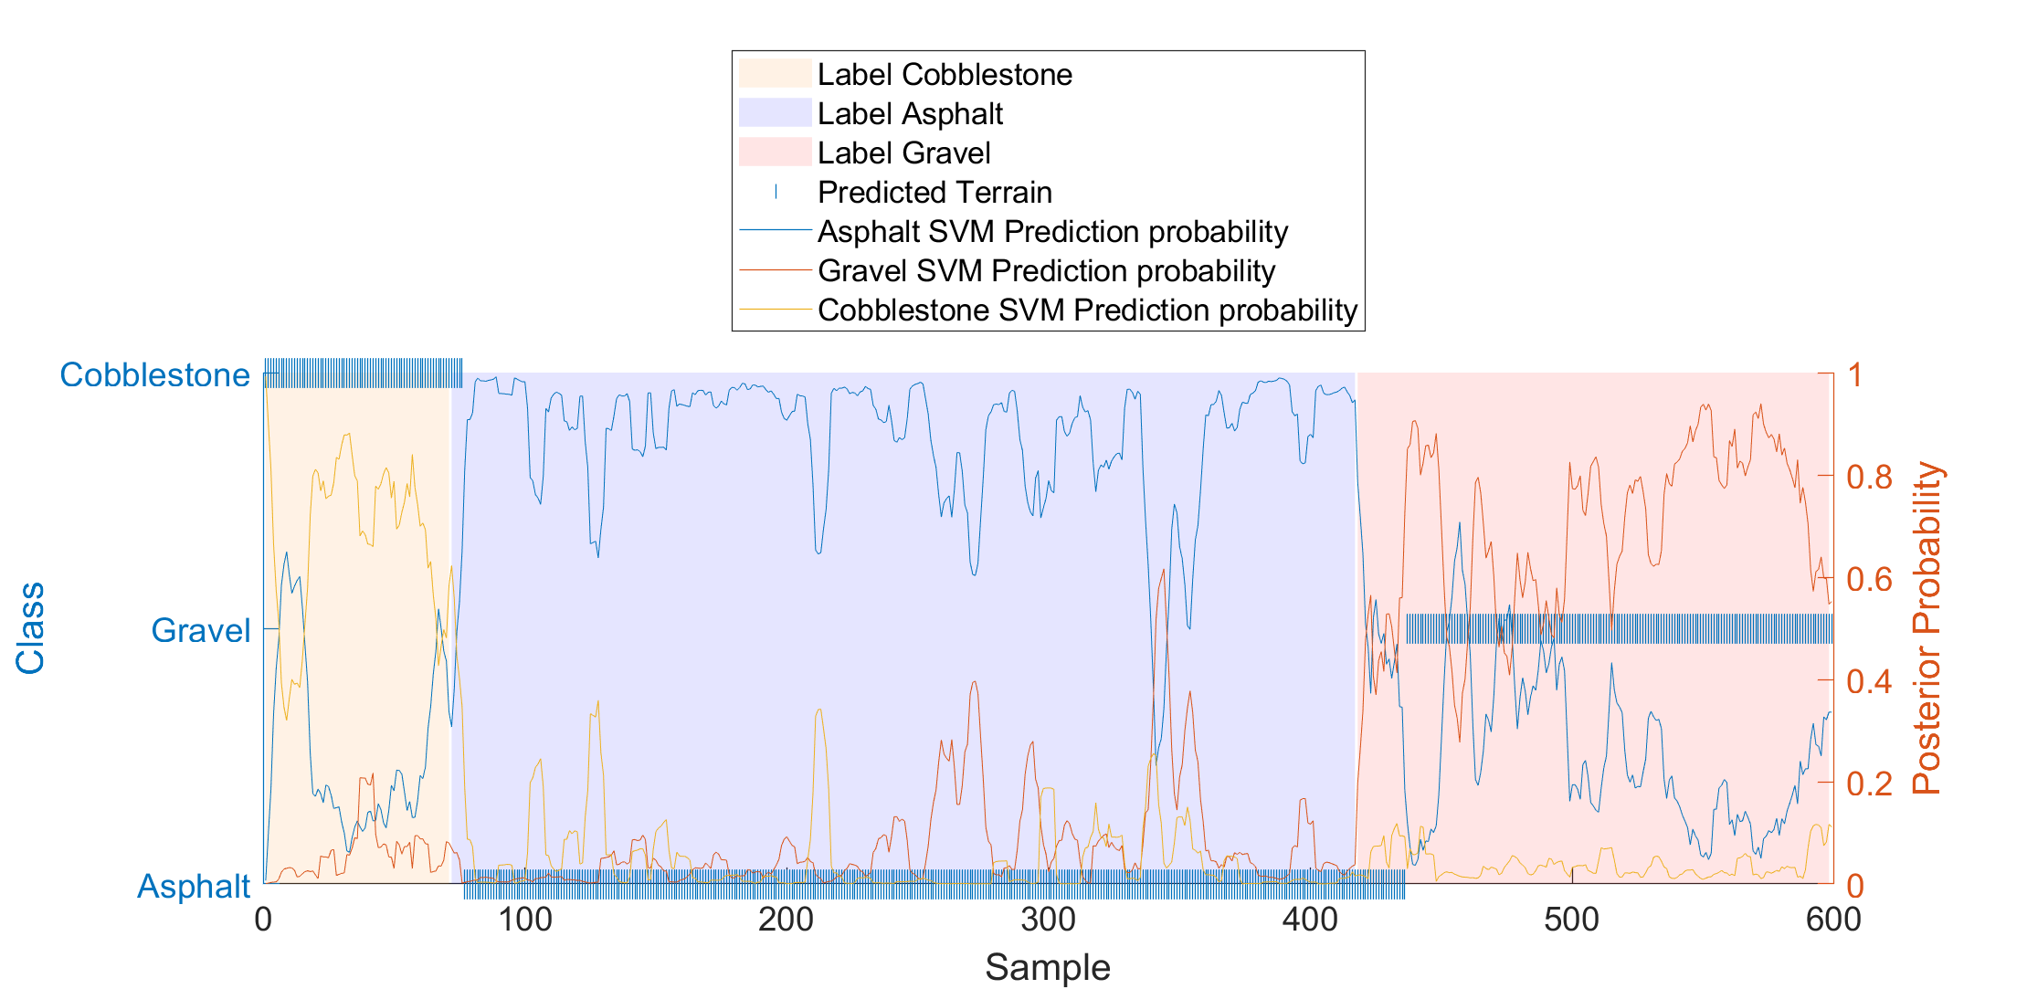
Classification Algorithm – Test 1
During the first test, in two occurrences the model misclassify the input.
Cobblestone
Asphalt
Gravel

Slide 19
Outline
Introduction
Data acquisition
Preprocessing & Feature Extraction
Classification Algorithm
Conclusion

Slide 20
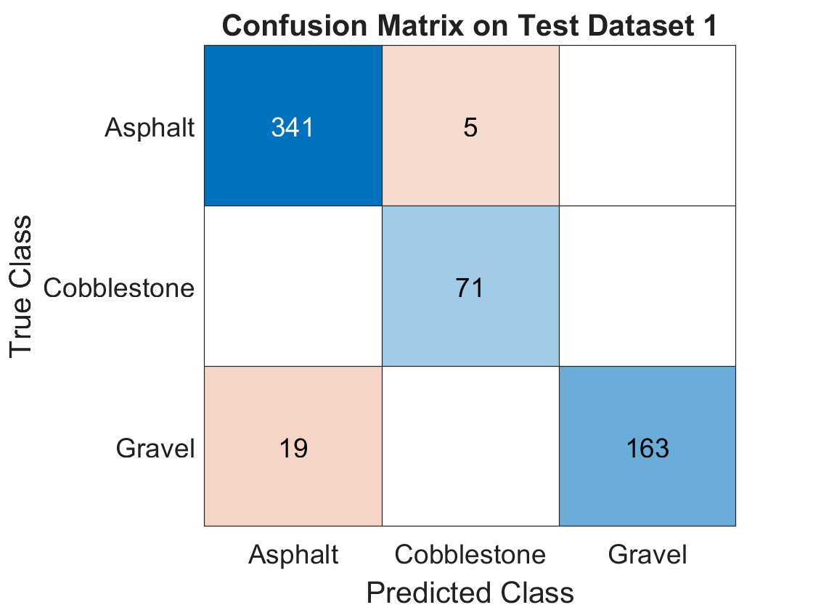
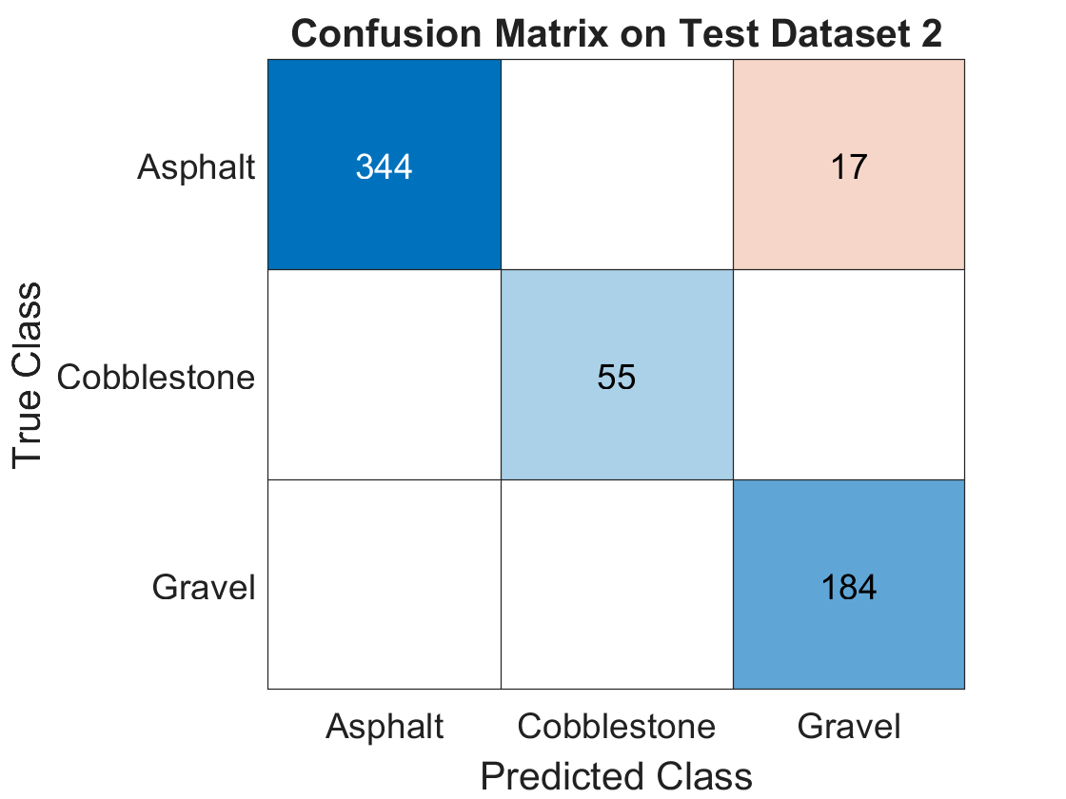



Conclusion – Accuracy
By analyzing the performance of the algorithm in the two test cases, it can be confirmed that adequate accuracy is achieved.
96%
Accuracy
Duration of
13min 54s
599
Samples classified
97%
Accuracy
Duration of
14min 53s
600
Samples classified

Slide 21
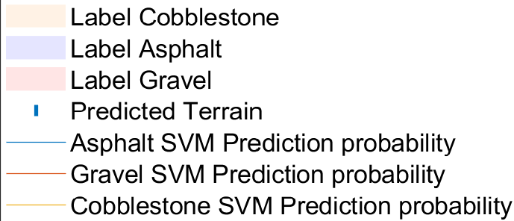
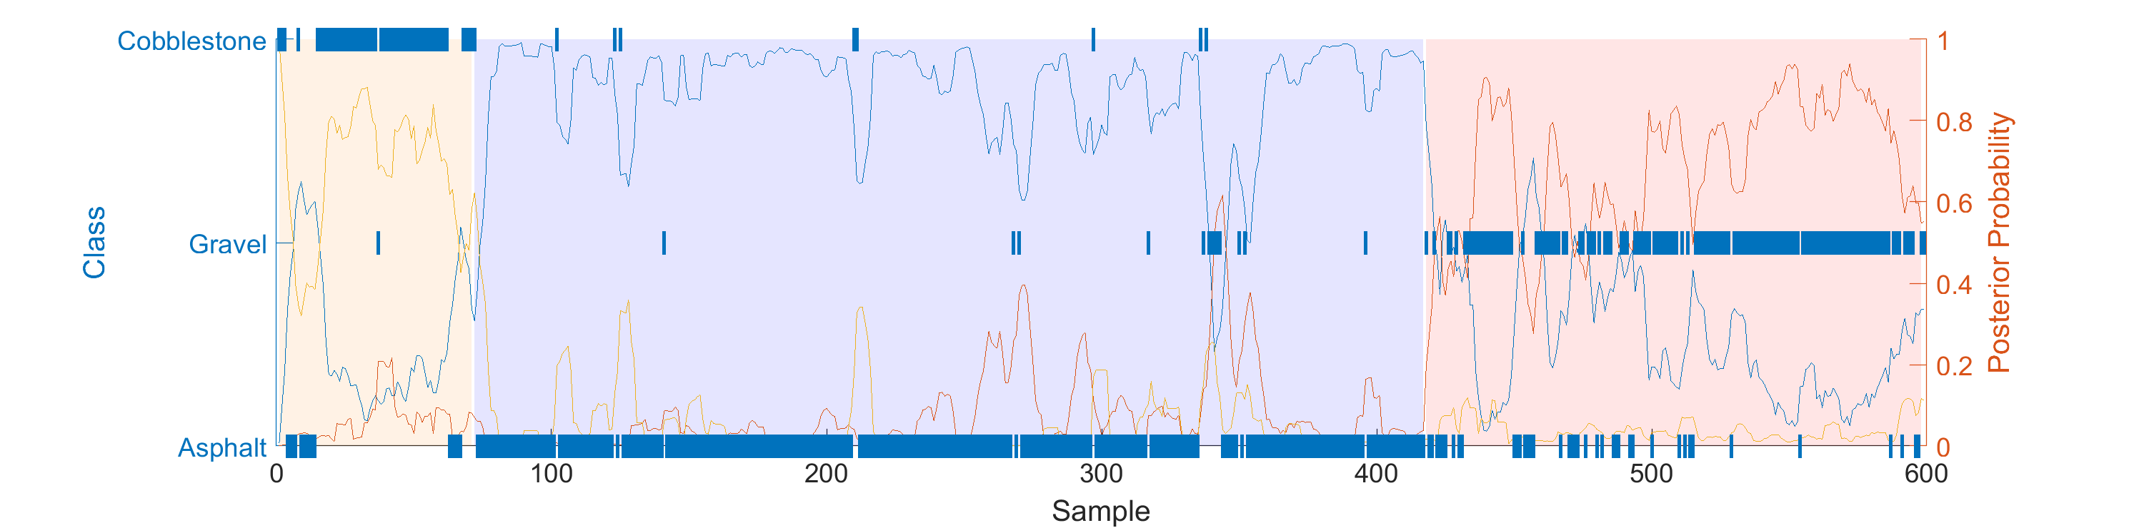
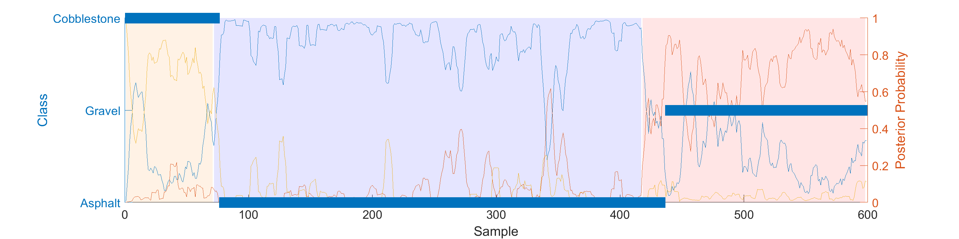
Conclusion – Output stability (Test 1)
Result without post-processing
Result with post-processing

Slide 22
Thanks for your attention
Master Degree in
COMPUTER ENGINEERING
SPEAKER
Cristiano Gambirasio
PLACE
University of Bergamo

